Slide 1
Hospitality Business Analysis
By Hitesh Sharma
February - 2025

Slide 2
Analysis Agenda
About AtliQ Grands
Data Model Overview
Dataset Details
Revenue Insights
Hospitality Business Analysis
Cancellation Analysis
Booking Trends
Key Recommendations
Conclusion

Slide 3
About AtliQ Grands
AtliQ Grands is a renowned five-star hotel chain in India, delivering luxury and business-class hospitality for over 20 years.
Hospitality Business Analysis
Presence Across Major Cities Operating in prime locations like Mumbai, Delhi, Bangalore, and Hyderabad, AtliQ Grands serves a diverse clientele, including corporate travelers and leisure guests.
The Business Challenge Despite its strong reputation, AtliQ Grands has been facing revenue decline and reduced market share due to increasing competition and inefficient decision-making.
Embracing Data-Driven Strategies To regain its position as an industry leader, AtliQ Grands is leveraging business intelligence and analytics to optimize revenue, enhance occupancy rates, and improve customer experience.

Slide 4
AtliQ
Bangalore
Delhi
Mumbai
Hyderabad

Slide 5
AtliQ
Bangalore
Delhi
Atliq Bay
Atliq Blu
Atliq City
Atliq Exotica
Atliq Grands
Atliq Palace
Mumbai
Hyderabad
Atliq Bay
Atliq Blu
Atliq City
Atliq Grands
Atliq Palace
Atliq Bay
Atliq Blu
Atliq City
Atliq Exotica
Atliq Grands
Atliq Palace
Atliq Seasons
Atliq Bay
Atliq Blu
Atliq City
Atliq Exotica
Atliq Grands
Atliq Palace

Slide 6
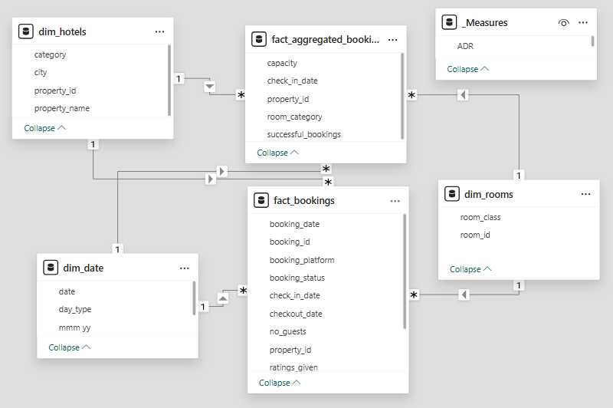
Data Model Overview
INTEGRATING DATASETS FOR ANALYSIS
Hospitality Business Analysis
This model integrates multiple datasets to analyze revenue, occupancy, and booking trends across AtliQ properties. It's designed to enable deeper insights.

Slide 7
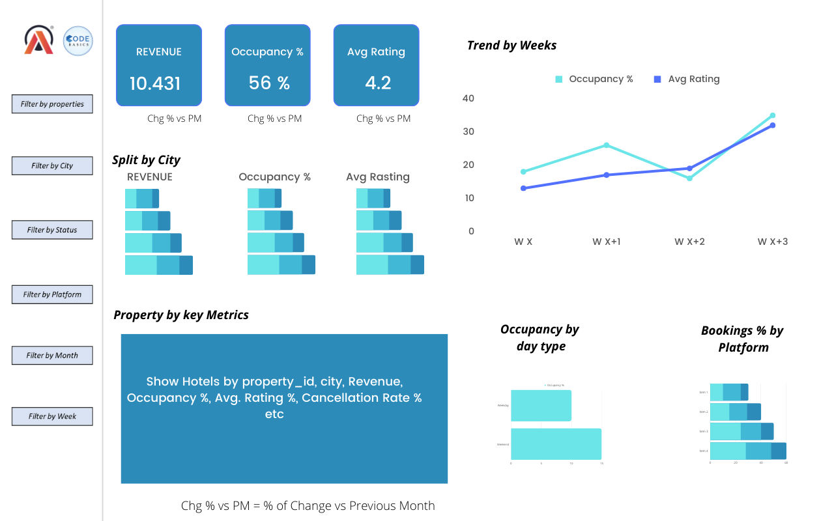
Mock Up For Dashboard

Slide 8
DATASET DETAILS
This table summarizes data sources used in the analysis. Each dataset serves a specific purpose for analyzing revenue and occupancy.
Dataset Type | Description | Duration
Booking Details | Data for 3 months | March - May 2023
Dim_date | Data about dates | Historical booking dates
Dim_hotels | Hotel details | Information on various properties
Dim_rooms | Room details | Information on types of rooms
Fact_aggregated_bookings | Aggregated Booking data | Summarized data overview
Fact_bookings | Individual Booking data | Detailed booking records

Slide 9
Revenue Insights
HIGHEST REVENUE CITY
The city with the highest revenue was Mumbai, showing a significant tourist interest and potential for future investments.
Hospitality Business Analysis
REVENUE TREND COMPARISON
KEY REVENUE CONTRIBUTORS
Revenue trends differentiated between weekdays and weekends revealed patterns that can inform promotional strategies.
Direct online bookings emerged as the primary contributor to overall revenue, showing the effectiveness of digital marketing.

Slide 10

Booking Trends
PEAK SEASON ANALYSIS
AVERAGE DAILY RATE (ADR)
TOP BOOKING SOURCE
Hospitality Business Analysis
Weekends showed a remarkable 63% occupancy rate, suggesting a higher demand during these periods.
The average daily rate stood at $13K, indicating the pricing strategy's potential profitability.
Online platforms were identified as the leading source for bookings, highlighting the need for optimized web presence.

Slide 11


Key Recommendations
ENHANCE GUEST EXPERIENCE
Focusing on improving guest services can help reduce cancellation rates and encourage repeat business.
Hospitality Business Analysis
OPTIMIZE DYNAMIC PRICING
Evaluating pricing strategies based on seasonal data can maximize bookings and revenue during peak times.

Slide 12

Thank You
For any queries, feel free to connect!
hiteshere18

